Slide 1

Retrospective look at car efficiency
By Karma Tsering

Slide 2
Motivation for the data analysis
Improving fuel efficiency is important
Financial, social and environmental benefits
  local ecosystems[1], aquatic contamination[2], and earthquakes[3]
30% of toxic emissions polluting the environment from transportation
Notes:
Improving fuel efficiency has financial as well as social and environmental benefits. Extraction of raw material to build these vehicles causes harm to local ecosystems[1], aquatic contamination[2], and earthquakes[3] so it would make sense to reduce the requirement of these raw materials to reduce their impact. Transportation is responsible for contributing 30% of toxic emissions polluting the envroment[4]. Fuel Efficiency can be improved with Advanced Design, Materials, and Technologies. Building models to predict the efficiency of the car can help consumers make better decisions and/or manufacturers by focusing their resources to minimize the negative impact because cars are here to stay.

Slide 3
About the data
Car data for 1970s and the ‘80s
Collection of 398 automobile records with 9 variables
3 categorical and 5 continues
Contain information such as the name, MPG, number of cylinders, horsepower, engine size, origin of the car and weight
Useful for practicing some analysis techniques and visualizations
Notes:
This dataset was taken from the StatLib library which is maintained at Carnegie Mellon University. The dataset was used in the 1983 American Statistical Association Exposition. This dataset was collected of car in the 1970s and the 1980s, contain information such as the name, MPG, number of cylinders, horsepower, engine size, origin of the car and weight. The Auto MPG sample data set is a collection of 398 automobile records with 9 variables, 3 of them are categorical and 5 are continues. This simple data can be very useful for practicing some useful analysis techniques and visualizations that you can then apply to your own data sets.

Slide 4
Data exploration
Data summary
 | MPG | Cylinders | Displacement | horsepower | Weight | Acceleration | Model_Year | Origin
count | 392.00 | 392.00 | 392.00 | 392.00 | 392.00 | 392.00 | 392.00 | 392.00
mean | 23.45 | 5.47 | 194.41 | 104.47 | 2977.58 | 15.54 | 75.98 | 1.58
std | 7.81 | 1.71 | 104.64 | 38.49 | 849.40 | 2.76 | 3.68 | 0.81
min | 9.00 | 3.00 | 68.00 | 46.00 | 1613.00 | 8.00 | 70.00 | 1.00
25% | 17.00 | 4.00 | 105.00 | 75.00 | 2225.25 | 13.78 | 73.00 | 1.00
50% | 22.75 | 4.00 | 151.00 | 93.50 | 2803.50 | 15.50 | 76.00 | 1.00
75% | 29.00 | 8.00 | 275.75 | 126.00 | 3614.75 | 17.03 | 79.00 | 2.00
max | 46.60 | 8.00 | 455.00 | 230.00 | 5140.00 | 24.80 | 82.00 | 3.00

Slide 5
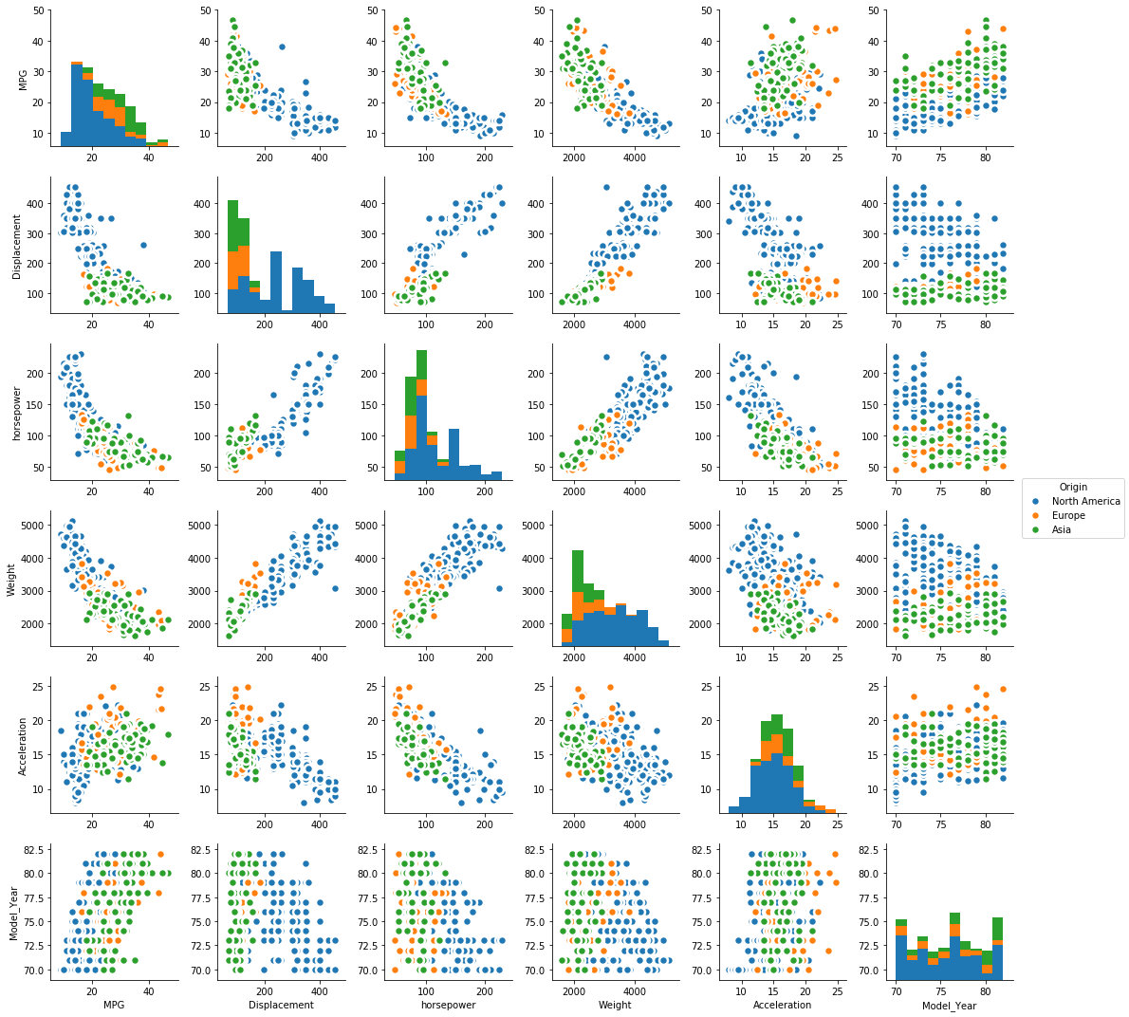
Data explorations
Seaborn pair plot
Look at how data relates to each other
Quick and dirty
Notes:
Graphical exploratory analysis using seaborn pair plot, a very handy tool to do a quick overview. Shows relationship between all the variables. Visualization of the graphs can allow to make decision of required non-linear transformation. The variable Origin’s values are replaced with their text counterpart for visualization purpose only, will not be used for analysis, it is a categorical variable therefore correlation information is irrelevant.

Slide 6
Regression Assumption
Linear relationship
  non-linear transformation function to a feature
Multivariate normality
  Kjg;iugi;ug
Homoscedasticity
  Standard error bias = continence interval
Consistent error distribution for predicted values

Slide 7
Data engineering
14 row of data removed due to nan value
Create dummy variables for the categorical variables
  Cylinder which has only 5 possible values
  Origin would be three continent
  Model year goes from 1970 to ’82(continues and/or categorical)
Non-linear transformation of features
Reduce multicollinearity between variables, normalize and minimize residual.
Notes:
I will do both to see how the efficiency/car in general changes over time.
Since the outcome is going to me regression, I will have to create linear relation between outcome and the variables, reduce multicollinearity between variables, and minimize residual.

Slide 8
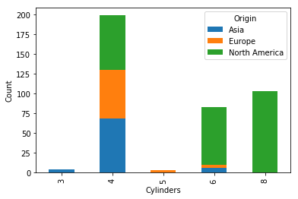
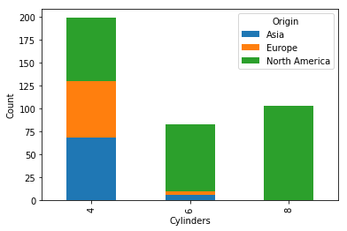
Bias

Slide 9
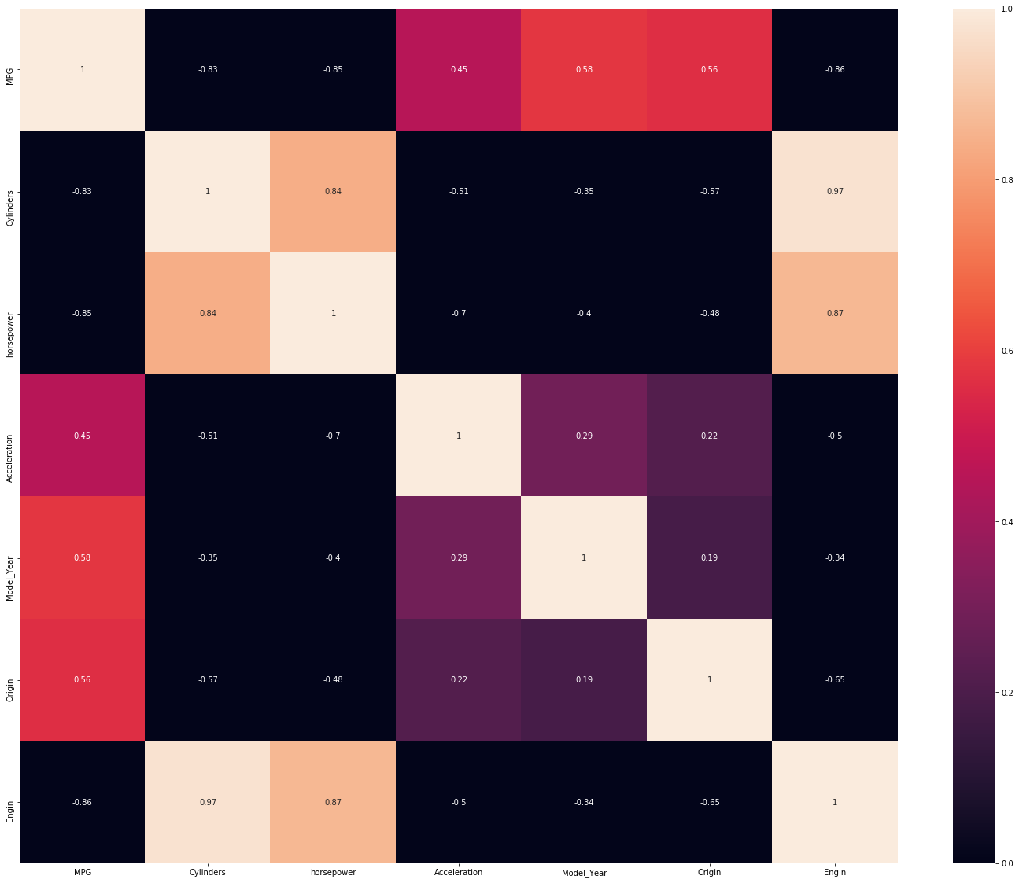
Correlation
Heat map
Removing Acceleration
Cylinder Vs. horsepower
Engine =
  Weight + Displacement
Cylinder and Origin

Slide 10
Ordinary least squared (OLS)
Ridge vs. Lasso regression
OLS regression
  minimization MSE
Ridge regression
  Variables > observation
  Shrinks the coefficients
  Reduces model complexity
  Multi-collinearity
Lasso regression
  Reduces over-fitting
  Feature selection

Slide 11
Linear Support Vector Machines (SVM)
Many features (>10^6)
SVM - Optimal Hyperplane based on support vectors
  SVR uses the outcome variable as the support vectors
    Same as minimization of MSE
Notes:
Support vector used mainly for classification and dataset with many feature (>10^6)

Slide 12
Optimum Cross validation scores
 | K-1 | K-2 | K-3 | K-4 | K-5 | Average | Range
SVM | 85.82% | 86.81% | 88.12% | 88.22% | 89.67% | 87.73% | 3.85%
Ridge | 86.58% | 87.89% | 88.53% | 88.72% | 90.42% | 88.43% | 3.85%
OLS | 86.38% | 88.23% | 88.37% | 88.74% | 90.44% | 88.43% | 4.07%
Lasso | 86.44% | 88.15% | 88.42% | 88.75% | 90.45% | 88.44% | 4.01%

Slide 13
conclusion
All of the regression models performed great
  Differences in result is negligible
  Simple dataset
  After much data engineering
Feature creation was challenging
  Eigen feature - conceptual
Linear regression assumption don’t always hold
  Acceleration feature
All of the regression models performed great
  Differences in result is negligible
  Simple dataset
  After much data engineering
Feature creation was challenging
  Eigen feature - conceptual
Linear regression assumption don’t always hold
  Acceleration feature
Notes:
Challenge
Data engineering was the biggest challenge
What did I learn?
Learn about methods for logically dealing with the parameters which can seem daunting
Next project/ what I would do differently?
Add more variables such as price, material type, toxic emission by gas, catalytic convertor

Slide 14
Future work
Add more variables such as:
  price, material type, toxic emission by gas, catalytic convertor
  Safety rating

Slide 15
References
Williams, H.F.L., D.L. Havens, K.E. Banks, and D.J. Wachal. 2008. Field-based monitoring of sediment runoff from natural gas well sites in Denton County, Texas, USA. Environmental Geology 55:1463–1471.
Burton, G.A., K.J. Nadelhoffer, and K. Presley. 2013. Hydraulic fracturing in the state of Michigan: Environment/ecology technical report. University of Michigan. September 3.
National Research Council. 2013. Induced seismicity potential in energy technologies. Washington, DC: The National Academies Press.
Kahn Ribeiro, S., S. Kobayashi, M. Beuthe, J. Gasca, D. Greene, D. S. Lee, Y. Muromachi, P. J. Newton, S. Plotkin, D. Sperling, R. Wit, P. J. Zhou (2007). Transport and its infrastructure. In Climate Change 2007: Mitigation. http://www.ipcc.ch/publications_and_data/ar4/wg3/en/ch5.html

Slide 16
Compare
Cross validation scores
 | K-1 | K-2 | K-3 | K-4 | K-5 | average | Range
Lasso | 62.35% | 70.20% | 70.72% | 72.49% | 73.12% | 69.78% | 10.76%
SVM | 84.29% | 86.07% | 86.20% | 87.80% | 87.84% | 86.44% | 3.55%
Ridge | 84.29% | 86.07% | 86.20% | 87.80% | 87.84% | 86.44% | 3.55%
OLS | 83.96% | 86.01% | 86.82% | 88.23% | 89.00% | 86.80% | 5.04%

